Slide 1
AI EXPENSE TRACKERWith RAG Enhanced Financial Reasoning
Presented By : Raaj Patel
Subject : Final Project Presentation

Slide 2
Abstract
Overview of combining SQLite analytics with RAG and LLM reasoning for reliable financial insight.

Slide 3
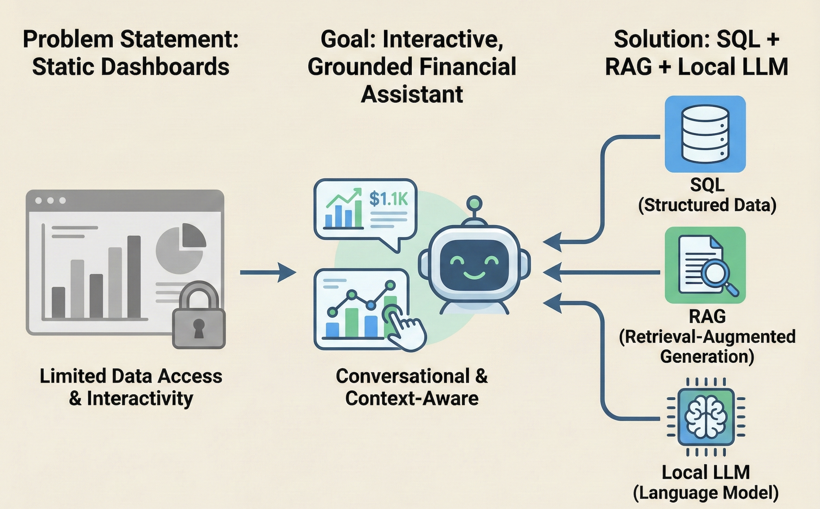
Introduction

Slide 4
Problem Definition
Answer natural financial queries
Retrieve accurate SQL-backed information
Local privacy-focused processing
Detect anomalies and budgets
Reduce hallucinations using RAG

Slide 5
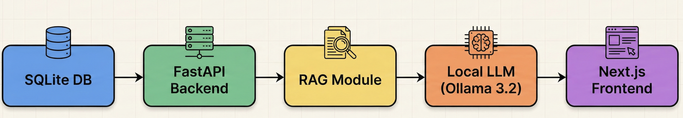
System Architecture

Slide 6
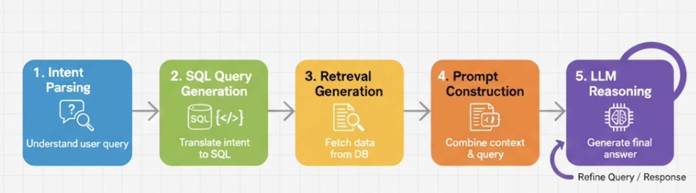
RAG Pipeline

Slide 7
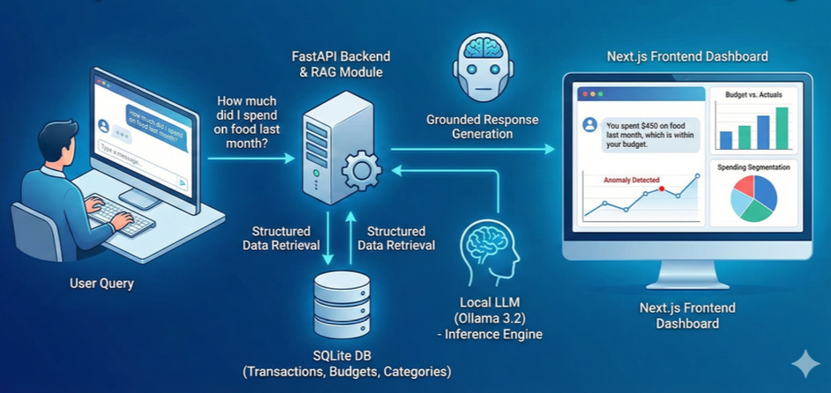
Data Flow Overview
User Query → SQL Analytics → RAG → LLM → Dashboard Output

Slide 8
Dataset & Experimental Setup
Synthetic data (18 transactions)
SQLite 3.43, FastAPI, Next.js, Ollama 3.2
Local CPU inference only.

Slide 9
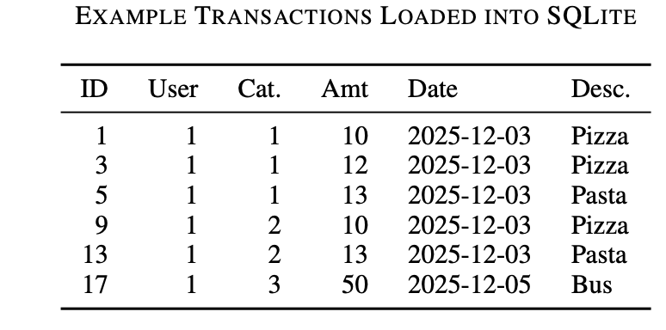
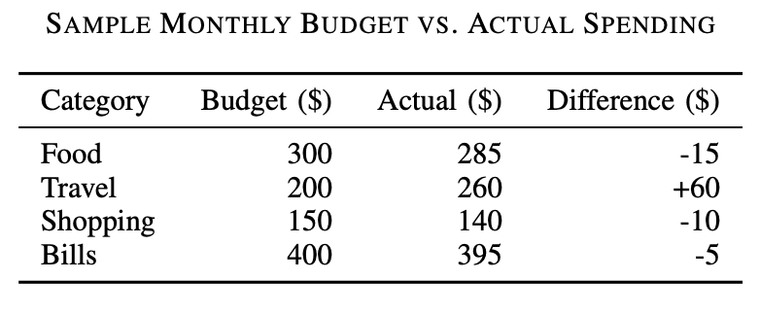
Example Transactions
Categories: Food, Travel, Shopping, Bills
Budgets vs Actual Spending stored monthly.

Slide 10
Evaluation Summary
Query Accuracy: 96.5%
Reduced Hallucinations: 10 → 1
Better anomaly precision & clustering score.

Slide 11
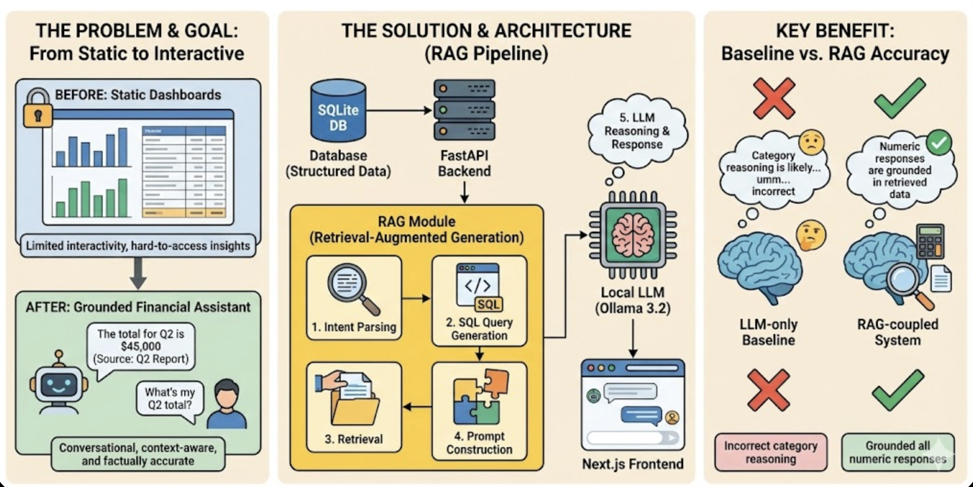
Baseline vs RAG
LLM-only baseline had incorrect category reasoning.
RAG-coupled system grounded all numeric responses.

Slide 12
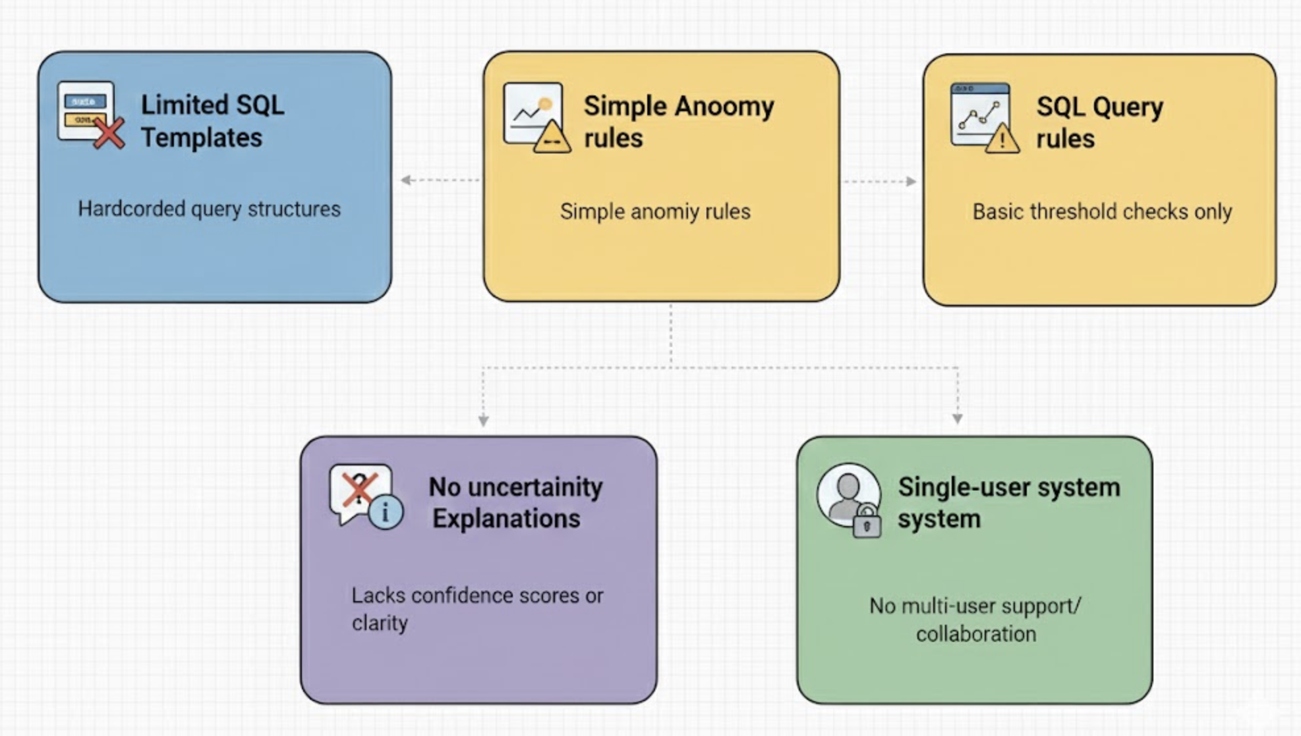
Limitations

Slide 13
Conclusion
Hybrid SQL + RAG + LLM system gives stable, accurate financial analysis.
Improves trustworthiness of responses.

Slide 14
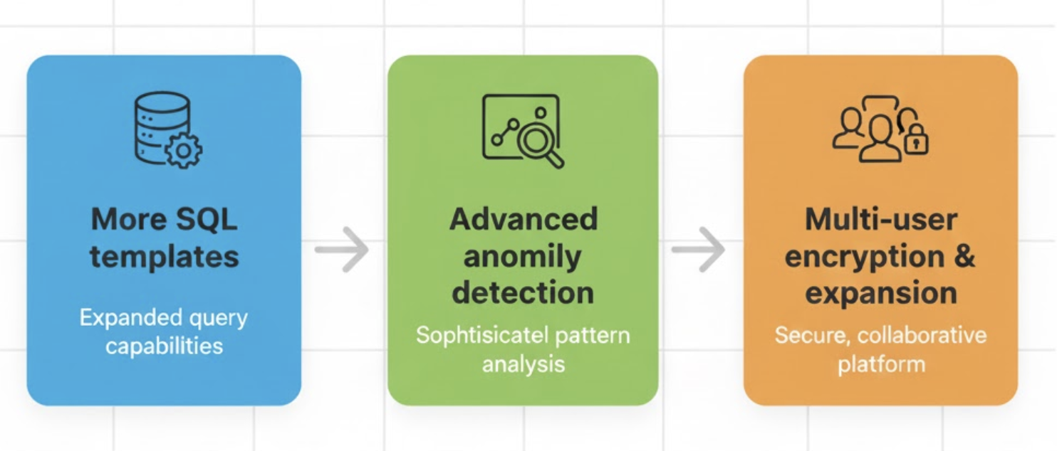
Future Work

Slide 15
References
K. Lewis et al., “Retrieval-Augmented Generation for Trustworthy AI,” 2023.
SQLite Consortium, “SQLite Documentation,” 2024.
S. Tiangolo, “FastAPI Documentation,” 2024.
F. Pedregosa et al., “Scikit-Learn: Machine Learning in Python,” JMLR, 2011.
J. MacQueen, “K-Means Clustering,” 5th Berkeley Symposium, 1967.
Y. Zhang et al., “Anomaly Detection in Time Series: A Survey,” ACM CSUR, 2021.
P. Lewis et al., “RAG for Knowledge-Intensive NLP,” NeurIPS, 2020.
Meta AI, “LLaMA 3 Model Card,” 2024.
T. Dettmers et al., “GPTQ: Accurate Post-Training Quantization for LLMs,” 2023.
T. Yu et al., “Spider: A Large-Scale Dataset for Text-to-SQL Semantic Parsing,” EMNLP, 2018.
M. Bostock, “D3.js Data Visualization Library,” 2024.
C. Ware, Information Visualization: Perception for Design, Morgan Kaufmann, 2021

Slide 16
Thank you

